Slide 1
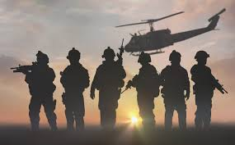
IOT BASED SOLDIER TRACKING AND HEALTH MONITORING SYSTEM
INTERNAL GUIDE SUBMITTED BY;
Mrs .M.VIJAYAGANDHI. M Tech , AP/ECE. M.ABIRAMI (951221106002)
N.MURUGESHWARI (951221106026)
S.SAKTHIDEVI (951221106037)
K.THANGA DURAICHI (951221106050)

Slide 2
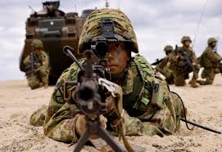
Agenda
Introduction
Motivation of the project
Objective
Literature survey
Existing approach
Proposed method
Block diagram
Hardware/software required tools
Result
Conclusion

Slide 3
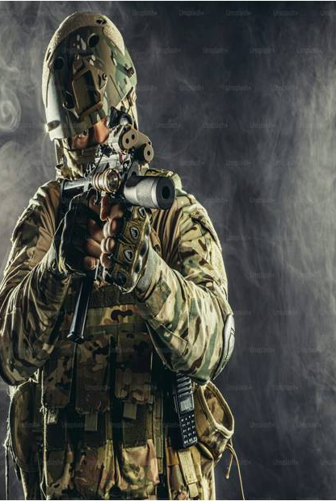
Introduction
India has over 1.4 million soldiers working in different and tough areas. Health problems, tiredness, and slow communication can be big risks for their safety and missions.
The IoT-based Soldier Tracking and Health Monitoring System uses devices like the ESP32, GSM SIM900A, GPS, temperature and heart rate sensors, and an LCD display to check the soldier’s location and health in real time.
It also sends automatic SMS or email alerts to get quick medical help in case of emergencies.

Slide 4
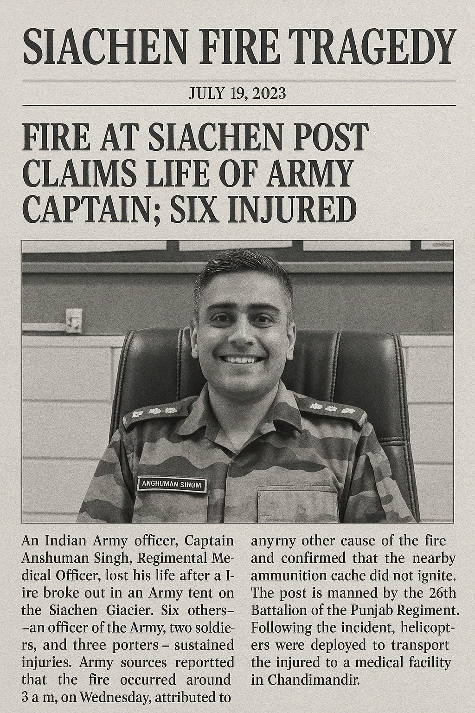
Motivation of the project
Recent incidents like:
*Siachen fire tragedy (2023)* – loss of Captain Anshuman Singh
* IED blast in J&K (2025)* – 2 soldiers lost
Around *1,600 soldiers die annually* in India due to non-combat reasons (health issues, accidents, lack of timely aid).
Soldiers in remote areas face *delayed medical attention* due to lack of real-time monitoring.
Need for a *proactive system* to monitor health and ensure *timely intervention* during emergencies.
Leverage *IoT and cloud technology* to provide *continuous tracking, early alerts, and faster response*.

Slide 5
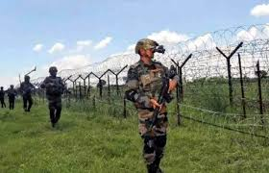
OBJECTIVE
To Track Soldier’s location in real-time by using GPS Tracking Device.
To monitor soldiers health condition by using Biometric Sensors. These sensors continuously monitor vital signs such as heart rate, body temperature.
To includes a danger switch that the soldier can press manually

Slide 6
Literature survey
S.No | Author(s) | Title | Proposed Methods | Journal / Conference | Year
1 | J. Lakshmi Prasanna, M. Ravi Kumar, Chella Santhosh, S.V. Aswin Kumar, P. Kasulu | IoT Based Soldier Health and Position Tracking System | Heartbeat & temperature sensors, GPS, NodeMCU, Arduino Nano; LiveTrack for location & vitals | IEEE 6th Int. Conf. on Computing Methodologies and Communication (ICCMC) | April 2022
2 | Dharam Buddhi, Abhishek Joshi (Retracted) | Tracking Military Soldiers Location and Monitoring Health using ML and LoRa | LoRaWAN, GPS, heartbeat/temp sensors, K-Means clustering; WBASN; cloud analytics | IEEE 2nd Mysuru Sub Section Int. Conf. (MysuruCon) | Nov 16–17, 2022
3 | Govarthan R, J. John Paul, Hariharan S, M.A.P. Manimekalai, Thusnavis B. Mary, K. Thilagavathi | IoT Based Health Monitoring and Tracking in Combat | ESP8266 Wi-Fi, DHT11, heart rate sensors, GPS, cloud upload, panic button | IEEE 4th Int. Conf. on Signal Processing and Communication (ICSPC) | Mar 23–24, 2023
4 | Sujitha V, Vishnu Sanjana V, Sudarmani R, P. Vigneswari, Aishwarya B | IoT Based Healthcare Monitoring and Tracking System for Soldiers using ESP32 | ESP32 with biomedical sensors, GPS, panic button, bomb detector; wireless WBAN; edge & cloud | IEEE 6th ICCMC | April 2022
5 | Dr. B. Veerasamy, B. Gayathri Durga, T. Harish Muthu Kumaran, Innamuri V. Devika, M. Jeya Akshaya | Soldier Health Detection and Position Tracking using LoRaWAN Sensor | LoRaWAN, STM32, GPS, SP02, temperature sensors; emergency alert; real-time cloud sync | IEEE 7th Int. Conf. on Trends in Electronics and Informatics (ICOEI) | Apr 13–14, 2023

Slide 7
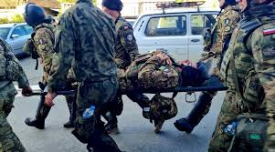
Existing approach​
Manual Health Checks: Field medics or team leaders manually assess soldiers’ health, which may miss early signs of fatigue or medical issues.
Delayed Emergency Response: Without real-time monitoring, emergencies like sudden illness or injury can go unnoticed, causing delays in medical aid.
Limited Connectivity: Traditional systems lack GPS tracking and remote monitoring, making it difficult for command centers to locate soldiers or assess their condition instantly.

Slide 8
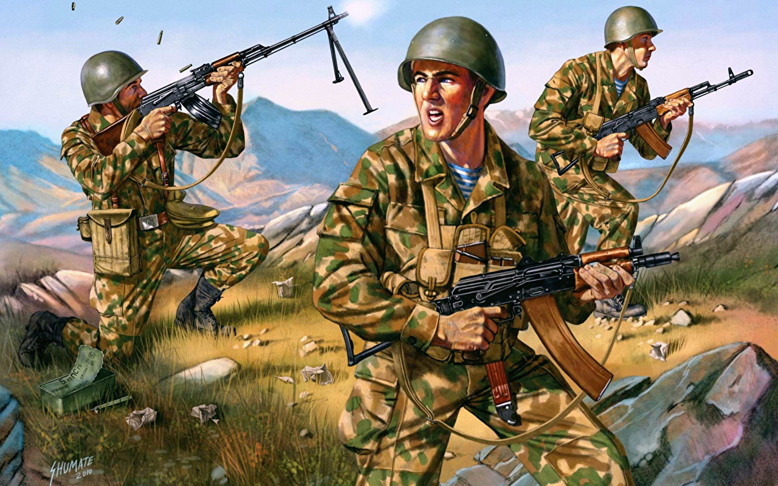
PROPOSED METHOD:
Heartbeat & Temperature Sensing → LMS358 sensor measures heart rate → LM35 sensor checks body temperature
GPS-Based Location Tracking → GPS module tracks soldier’s real-time position
Smart Data Processing →ESP32 collects & analyzes data → Detects abnormal health conditions
Emergency SMS Alerts → GSM SIM900A sends SMS with location & health info to control room

Slide 9
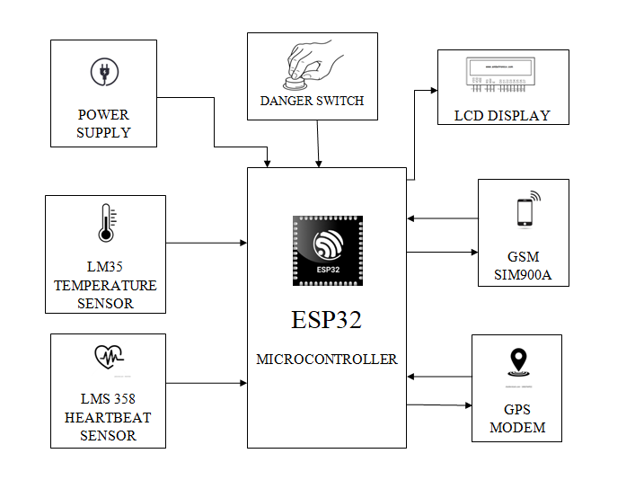
Block diagram

Slide 10
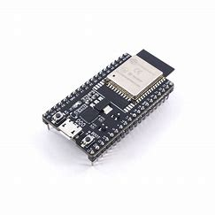
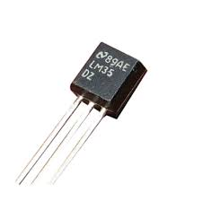
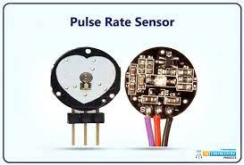
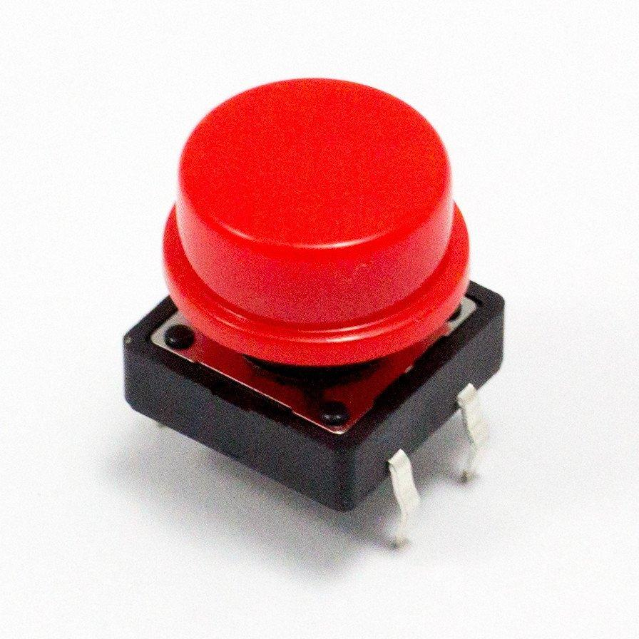
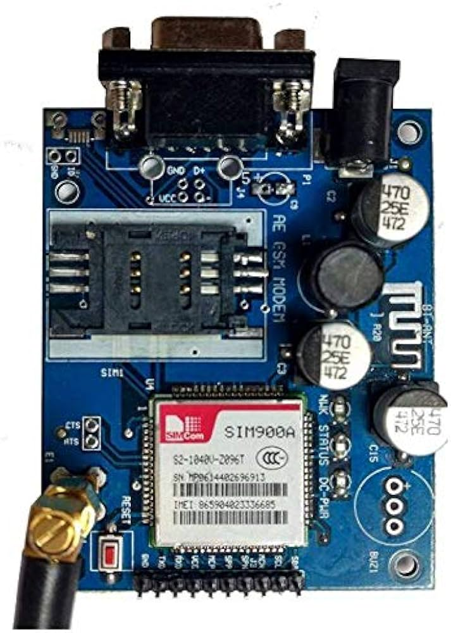
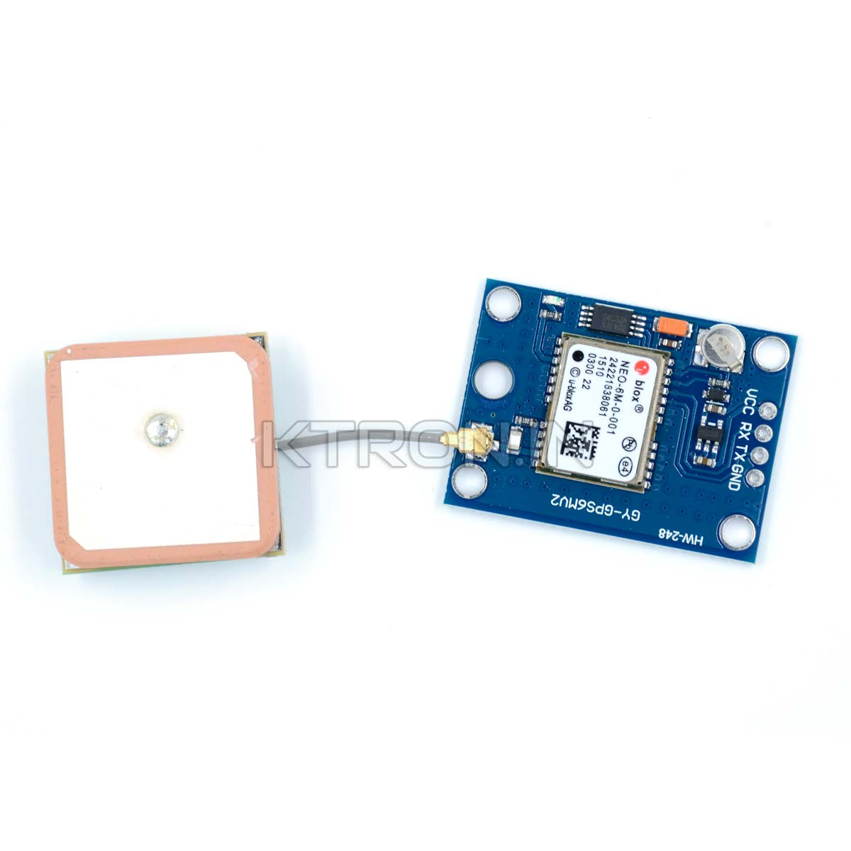
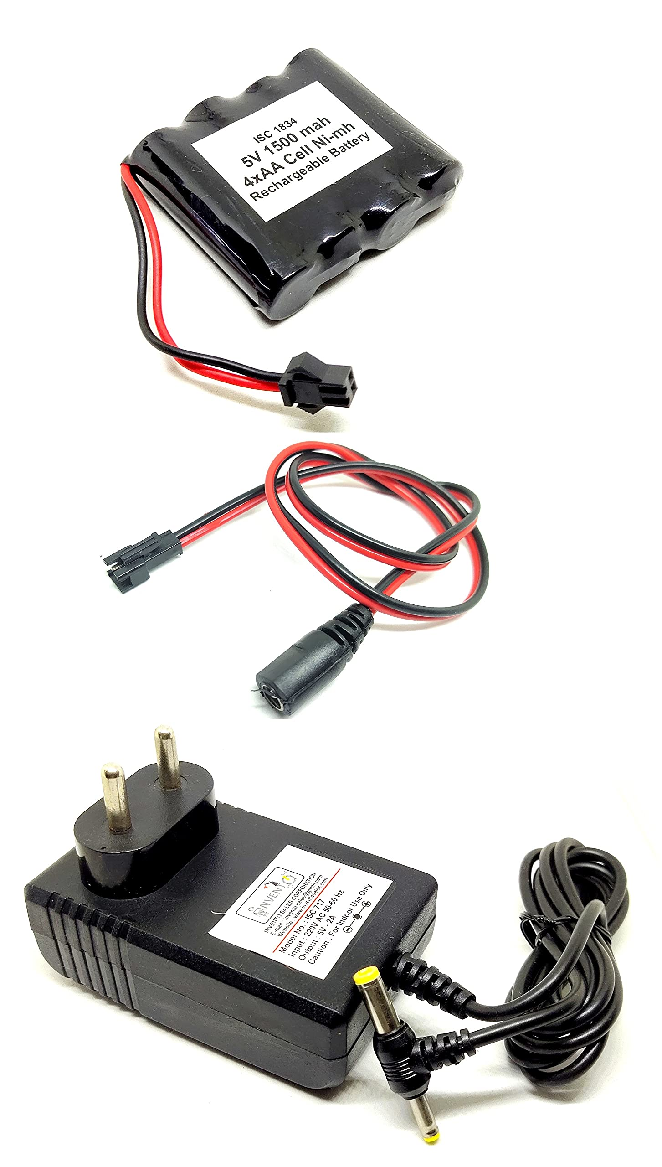
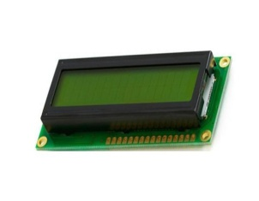
HARDWARE REQUIREMENTS
ESP32
Temperature Sensor (LM35)
Heart Rate Sensor (LMS358)
Danger Switch
GSM (SIM900A)
GPS Module
Power supply
LCD Display

Slide 11
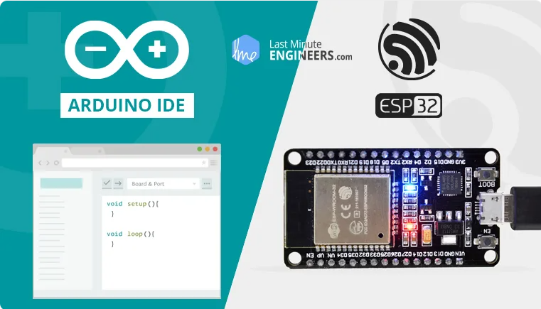
SOFTWARE REQUIREMENTS :
ARDUINO IDE

Slide 12
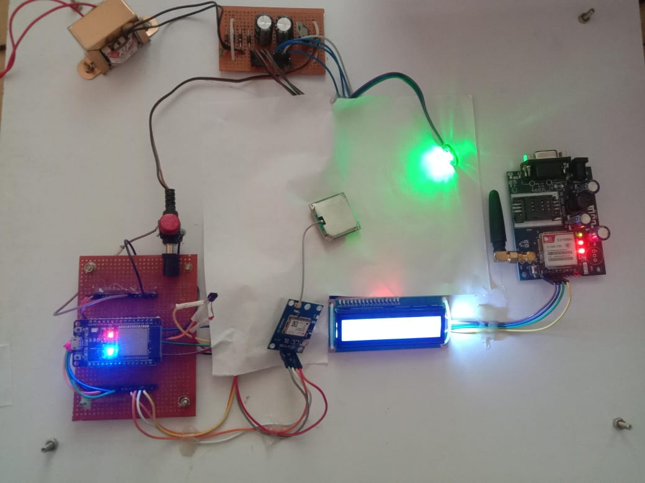
RESULT:

Slide 13
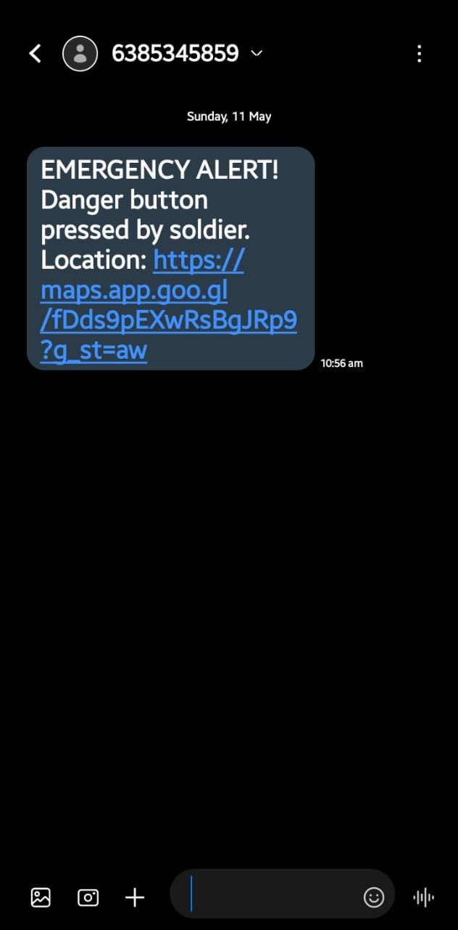
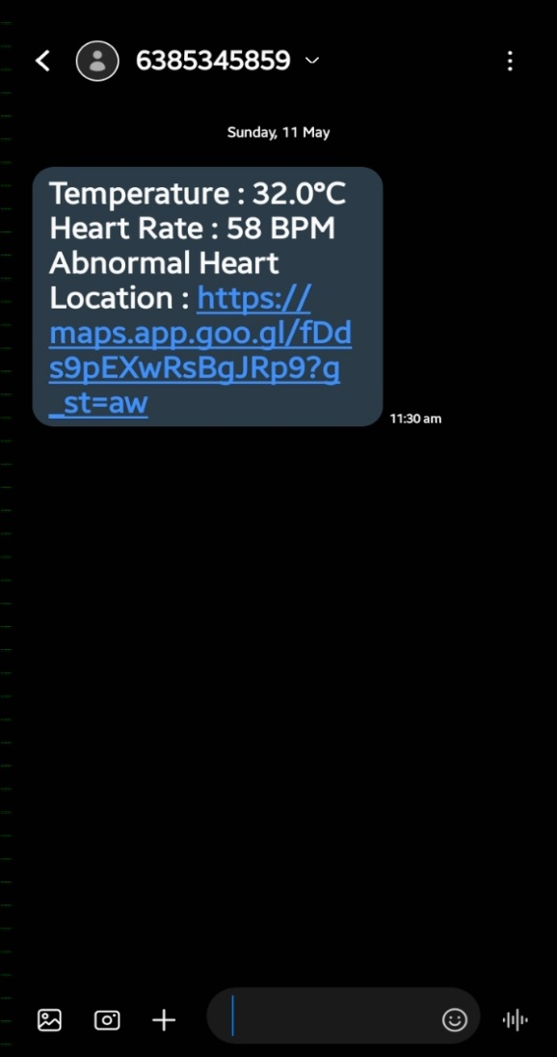
RESULT:

Slide 14
CONCLUSION
🧠 Enables intelligent decision-making by providing commanders with live health and location data.
📶 Works effectively even in remote locations where traditional communication systems may fail.
⚙️ Designed with user-friendly components and can be easily maintained or upgraded in the field.
🔋 Uses energy-efficient hardware, making it suitable for long missions without frequent recharging.
🚨 The danger switch or automatic alert trigger allows instant communication during unforeseen emergencies.
💡 Demonstrates a smart and scalable model for future military healthcare and surveillance systems

Slide 15
REFERENCE
Govarthan R, J. John Paul, Hariharan S, M. A. P. Manimekalai, Thusnavis Bella Mary, and K. Thilagavathi, "IoT Based Health Monitoring and Tracking in Combat,"4th International Conference on Signal Processing and Communication (ICSPC), IEEE, 2023.
Dr. B. Veerasamy, B. Gayathri Durga, T. Harish Muthu Kumaran, Innamuri V. Devika, and M. Jeya Akshaya, "Soldier Health Detection and Position Tracking System using LoRaWAN Sensor,"7th International Conference on Trends in Electronics and Informatics (ICOEI), IEEE, 2023.
J. Lakshmi Prasanna, M. Ravi Kumar, Chella Santhosh, S. V. Aswin Kumar, and P. Kasulu, "IoT Based Soldier Health and Position Tracking System,"6th International Conference on Computing Methodologies and Communication (ICCMC), IEEE, 2022.
Dharam Buddhi and Abhishek Joshi,"Tracking Military Soldiers Location and Monitoring Health using ML and LORA model"(Retracted),2nd Mysore Sub Section International Conference (MysuruCon), IEEE, 2022.
Sujitha V, Vishnu Sanjana V, Sudarmani R, P. Vigneswari, and Aishwarya B, "IoT Based Healthcare Monitoring and Tracking System for Soldiers using ESP32," 6th International Conference on Computing Methodologies and Communication (ICCMC), IEEE, 2022.

Slide 16
THANK YOU

